Slide 1

CLINICAL ALGORITHM RULES
We are working on an initiative where we are required to have a service which can work on some sort of rules. And it should be as configurable as possible.

Slide 2
AIM
We need to create an application which will flag a patient for higher scrutiny based on disease and other disorders. And since the rules of identification can change based on different studies thus the system must be flexible enough to incorporate the changes in the least disruptive manner.
For this we will use a rules engine, namely, Drools.
Technical Details:
Drools- A rules engine is a flexible piece of software that manages business rules.
Junit Test Cases- Test all possible scenarios.
Spring Boot- This will be required to create a REST API.
Postman- This will be required for API testing.

Slide 3
WORKING OF OUR RULES – Ruleset 1
Input
ICD10 Code
Status
Timeframe
If all the 3 conditions are true according to our business rules, then print disease(s).
Else print nothing.
False
True
Print Disease(s)
Print nothing(Null)

Slide 4
WORKING OF OUR RULES – Ruleset 1 & 2
ICD10 code for GERD
Status
Timeframe
DOB
GERD disease (Dependency on Ruleset 1 for GERD to be true)
False
RISK: ICD10 Status Timeframe DOB
True
Misc. other conditions for Risk- Smoking status, Age, Race & Gender
If all the Risk(S) conditions are true as per our business rules, then print risk factor(s) + disease(s).
Else print nothing for risks.
True
False
True
Print Disease(s) + Risk Factor(s)
Print Disease(s)

Slide 5
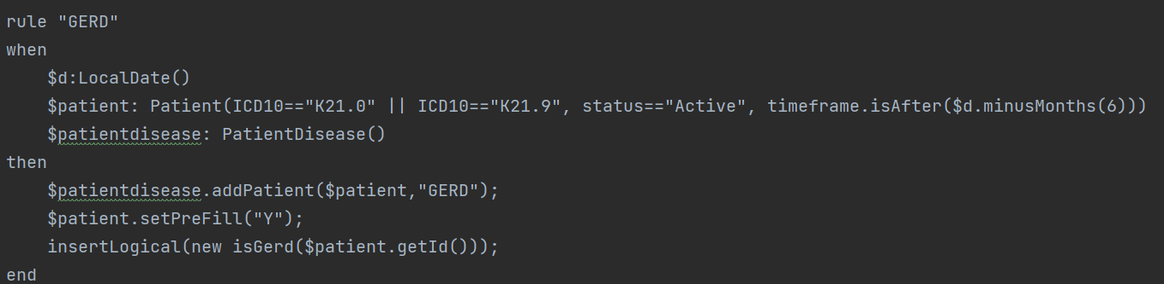
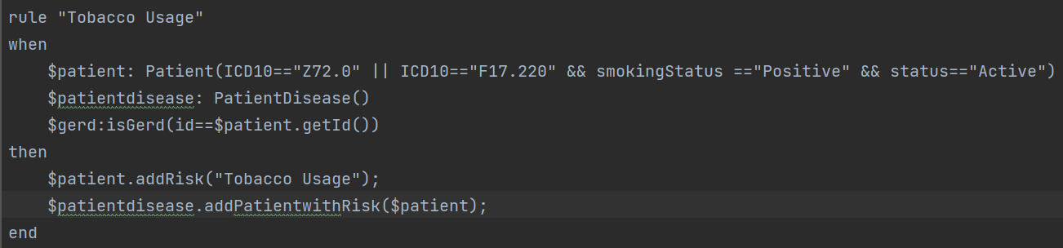
SAMPLE INPUT & OUPUT
SAMPLE RULE FROM RULESET 1 & 2

Slide 6
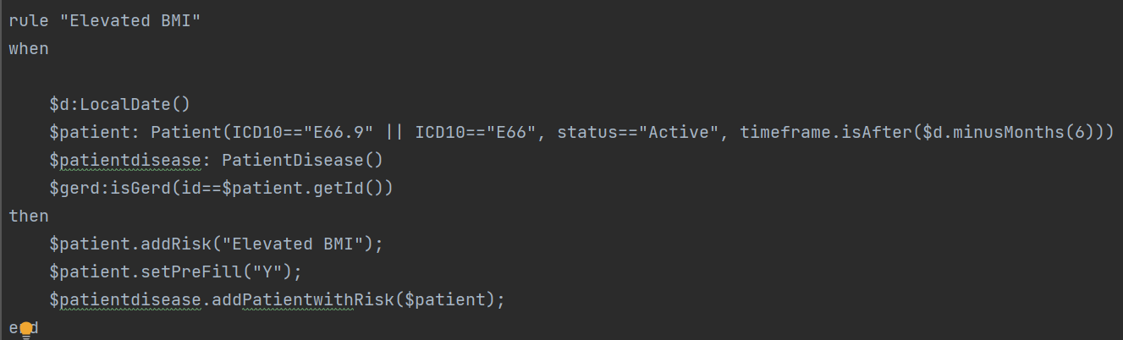
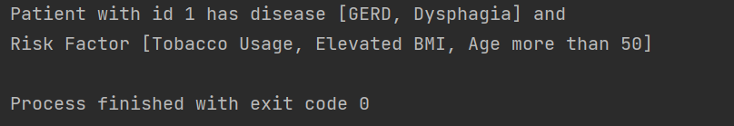
SAMPLE RULES CONTD.
OUTPUT:

Slide 7
JUNIT TESTS

Slide 8
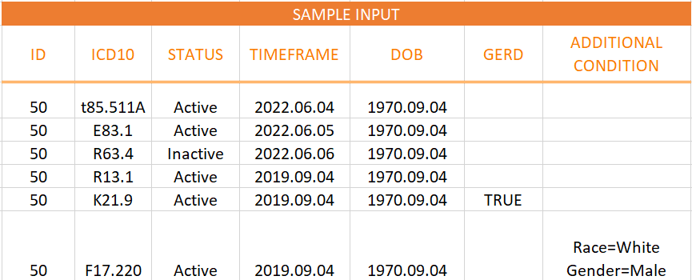
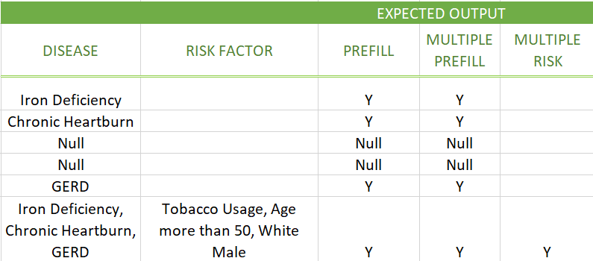
JUNIT TEST CASES
Input:
Output:

Slide 9
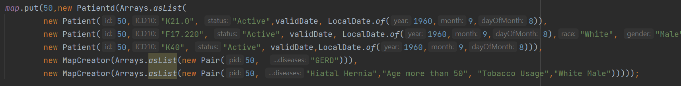
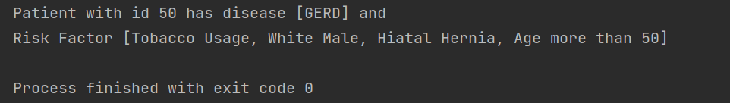
Input:
Output:
9

Slide 10
Clinical Algorithm Rules- API

Slide 11
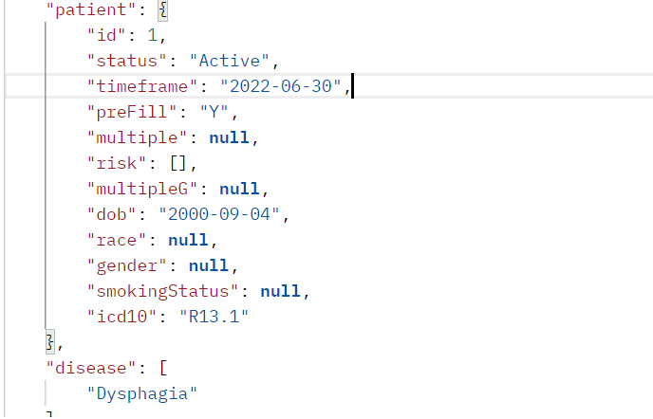
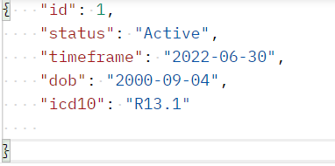
1. When only 1 disease is present
Input:
Output:

Slide 12
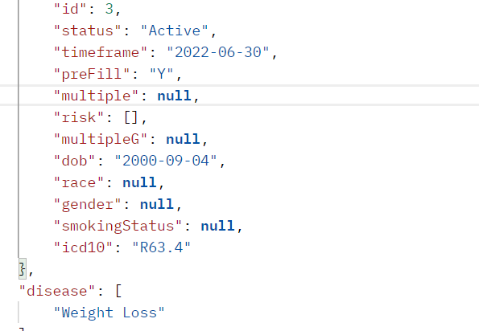
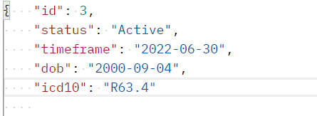
3. When multiple diseases are present
Input:
Output:

Slide 13
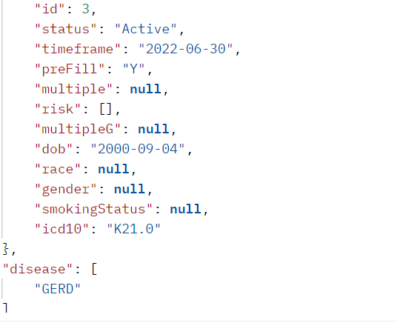
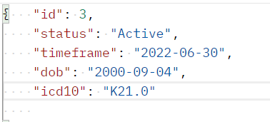
3. When multiple diseases are present
Input:
Output:

